Slide 1
PRESENTATION ON JOB PORTAL
DEVELOPED BY:
SIDHARTH GUPTA
UNDER THE GUIDANCE OF:
PROF. BALPREET KAUR

Slide 2
OBJECTIVE
The objective of the Job Portal System is to develop a system to enable interaction between employers and applicants.
In this project, the front-end involves HTML, CSS and the back-end involves Javascript.
A job portal is a platform dedicated to online information about recruiters as well as job seekers.
A job portal helps both job seekers and recruiters find the right organization for the employees.

Slide 3
INTRODUCTION
This project is aimed at developing an online search Portal for the Placement Details for job seekers.
The system is an online website that can be accessed throughout the organization and outside as well with proper login provided.
This system can be used as an Online Job Portal for job seekers. Job Seekers logging should be able to upload their information in the form of a CV. Visitors/Company representatives logging in may also access/search any information put up by Job aspirants.

Slide 4
PROJECT SCOPE
Maintain job posting details and generate various recruitments
Maintain Uploaded resumes.
Provide customized job postings.
Maintain Job seeker and Employer Record.
The project Job portal is aimed at developing a central Recruitment Process System for the HR(Human Resource) Group of a company. It provides the candidate's ability to register to this application and search for jobs, manage their accounts.

Slide 5
USER MODULES
Profile
The user can add and update their personal details on their profile page.
They will also need to add work experience, and key skills, and upload a CV.
Also, they can change their old password to the new one.
Home
The user can search for jobs and also the system will automatically search for jobs as per the skills and recruiter conditions.
They can view job details and apply for their desired job.

Slide 6
Applied
View all the previous jobs that they have applied for.
Chat with the recruiter for the jobs applied.
Chats
The user can view all their recent chats with the recruiter and also the chat page.
Notifications
The user will receive the notification of their chats.

Slide 7
RECRUITER MODULES
Profile
The recruiter can add and update their details on their profile page.
Change password
Also, they can change their old password to the new one.
Manage Jobs
The recruiter will be able to manage jobs and they can add, update, view and delete jobs.
They can add all the details about jobs.

Slide 8
Company details
The recruiter can add company details on the job portal.
They can view candidates and apply auto search with all the parameters added for a job such as experience, skills, salary and notice period.
The recruiter can also chat with candidates.
Candidates
The recruiter can manually search for candidates.
Name, experience, skills salary and notice period.
They can also chat with the candidates.
Applied List
The recruiter can view the list of all the candidates that applied and their details.
They can chat with candidates.
Chats
The recruiter can view their chat list and chat page
Notifications
The recruiter will also receive chats with candidates who applies for job.

Slide 9
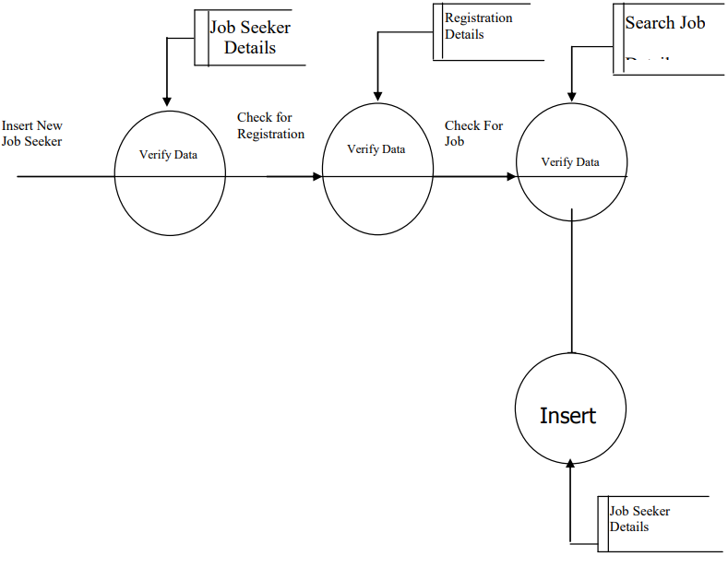
DATA FLOW DIAGRAM (DFD) 1ST LEVEL DFD

Slide 10
HARDWARE REQUIREMENTS
Laptop or PC
Windows 7 or higher
I3 processor system or higher
8 GB RAM or higher
100 GB ROM or higher

Slide 11
SOFTWARE REQUIREMENTS
Front End Client: Html, CSS
Web Server: Google chrome
Data Base Server: DB2
Back End: Java script, My SQL

Slide 12
ADVANTAGES
It is easy to maintain.
It is user-friendly.
The recruiter can find candidates as per the company’s requirements without facing a lot of difficulties.
The user can also find the jobs they are looking for.
Data storage and retrieval will become faster.

Slide 13
FUTURE WORK
This System being web-based and an undertaking of Cyber Security Division, needs to be thoroughly tested to find out any security gaps.
Language translator will be added in upcomping updates.
Video chats will also be added for the convience of both job recruiters and seekers.

Slide 14
CONCLUSION
It has been a great pleasure for me to work on this exciting and challenging project. This project provided practical knowledge of not only programming in web based application and no some extent Windows Application and SQL Server, but also about all handling procedure related with “JOB PORTAL”. It also provides knowledge about the latest technology used in developing web enabled application and client server technology that will be great demand in future. This will provide better opportunities and guidance in future in developing projects independently.

Slide 15
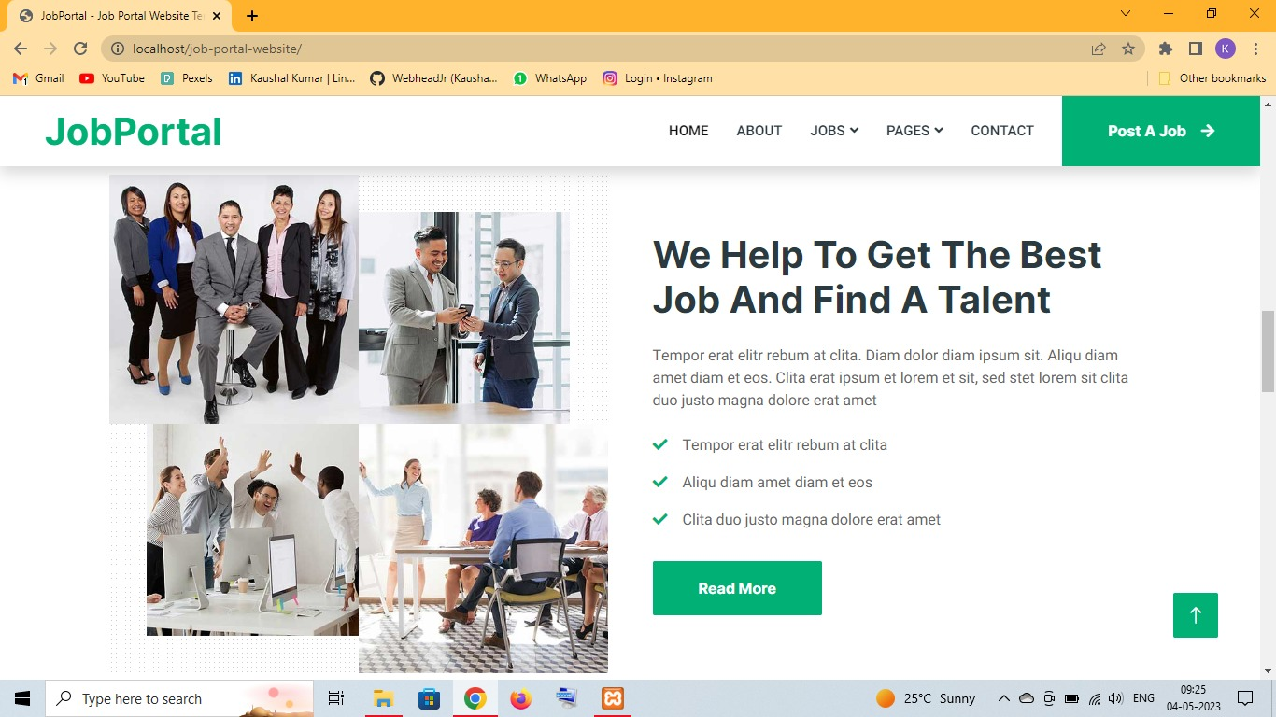
PROJECT OUTCOMES

Slide 16
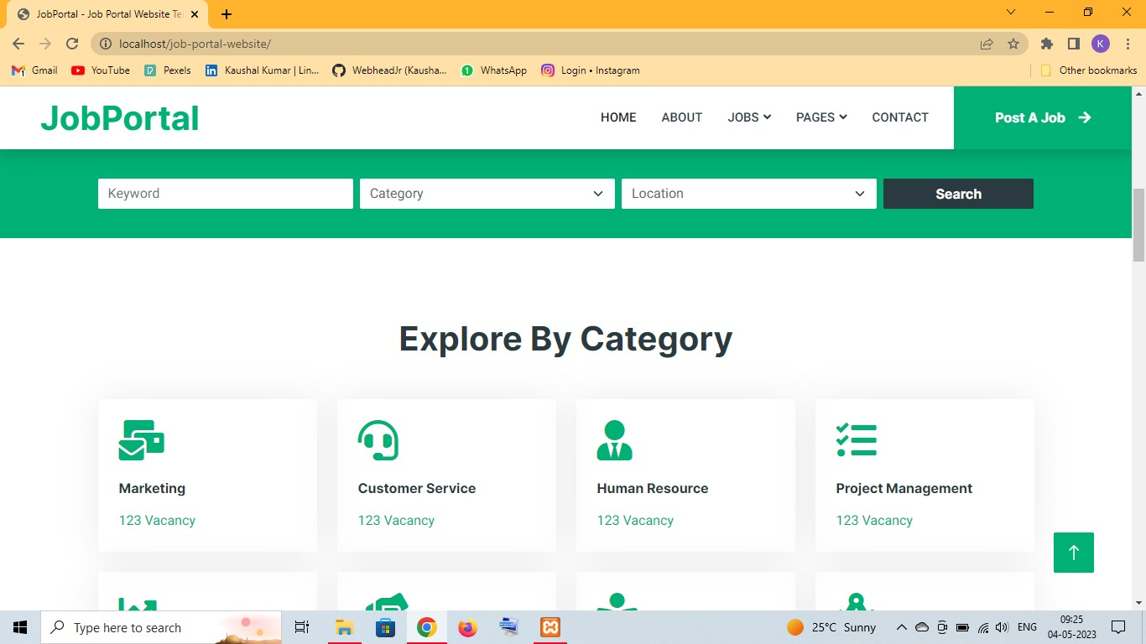

Slide 17
THANK YOU

